Slide 1
Digital Portfolio
STUDENT NAME: SAGANA .S
REGISTER NO AND NMID: 2428M0038
DEPARTMENT: BSc Data Science
COLLEGE: COLLEGE/ UNIVERSITY: Kumaraguru College of Liberal Arts and Science

Slide 2
PROJECT TITLE
Personal Portfolio Website
This project is a self-designed portfolio created using HTML to present my skills, academic background, and projects in a professional manner. The portfolio acts as a digital resume, showcasing my work, achievements, and contact details in a structured and user-friendly way. It highlights my ability to design and develop simple yet effective web solutions.

Slide 3


AGENDA
Problem Statement
Project Overview
End Users
Tools and Technologies
Portfolio design and Layout
Features and Functionality
Results and Screenshots
Conclusion
Github Link
3/21/2024 Annual Review

Slide 4

PROBLEM STATEMENT
Traditional resumes often fail to capture a person’s complete skills and projects in an engaging way. They are static, lack interactivity, and do not provide a digital presence that can be easily shared or accessed.
Solution The Personal Portfolio Website addresses this by creating an online space to showcase skills, academic background, and projects in a professional and user-friendly format. Built using HTML, it acts as a digital resume that is accessible anytime, enhances visibility, and presents information in an organized, modern way.

Slide 5

PROJECT OVERVIEW
The Personal Portfolio Website is a web-based project designed to present my skills, achievements, and projects in a professional and interactive manner. Developed using HTML (with CSS/JS if applied), it provides a clean and organized layout that highlights key information such as an "About Me" section, project showcases, and contact details. The portfolio serves as a digital resume, making it easier to share, accessible from anywhere, and a reflection of my web development abilities.

Slide 6

WHO ARE THE END USERS?
Recruiters & Hiring Managers – to quickly view your skills, projects, and experience.
College Faculty / Mentors – to assess your work for academic or internship purposes.
Peers & Collaborators – to explore your projects and connect for teamwork or collaborations.
Clients (if freelancing) – to check your capabilities before offering projects.
General Audience – anyone interested in knowing more about your background and work.

Slide 7

TOOLS AND TECHNIQUES
HTML5 – for structuring the portfolio pages
CSS3 – for styling and layout design
JavaScript (if used) – for interactivity and dynamic behavior
Code Editor (VS Code / Sublime / Atom) – for writing and managing code
Browser (Chrome / Edge / Firefox) – for testing and running the website
GitHub / Netlify (if hosted) – for deployment and version control

Slide 8
PORTFOLIO DESIGN AND LAYOUT
Simple & Clean UI – minimalistic design focusing on readability and professionalism.
Sections Included – Home, About Me, Projects, Skills, and Contact.
Navigation – easy-to-use menu for smooth browsing across sections.
Responsive Design – layout adjusts to different screen sizes (desktop, tablet, mobile).
Consistent Styling – uniform fonts, colors, and spacing for a professional look.
Project Showcase – grid/section format to highlight key projects with short descriptions.
8

Slide 9
FEATURES AND FUNCTIONALITY
Personal Introduction – Highlights background, skills, and academic details.
Project Showcase – Displays completed projects with descriptions and links.
Skills Section – Lists technical and soft skills in an organized way.
Contact Information – Provides email, phone, or links to connect.
Responsive Layout – Adjusts to different devices for better accessibility.
Simple Navigation – Easy-to-use menu for smooth movement between sections.
Digital Resume – Acts as an online CV, easily shareable with recruiters or peers.

Slide 10
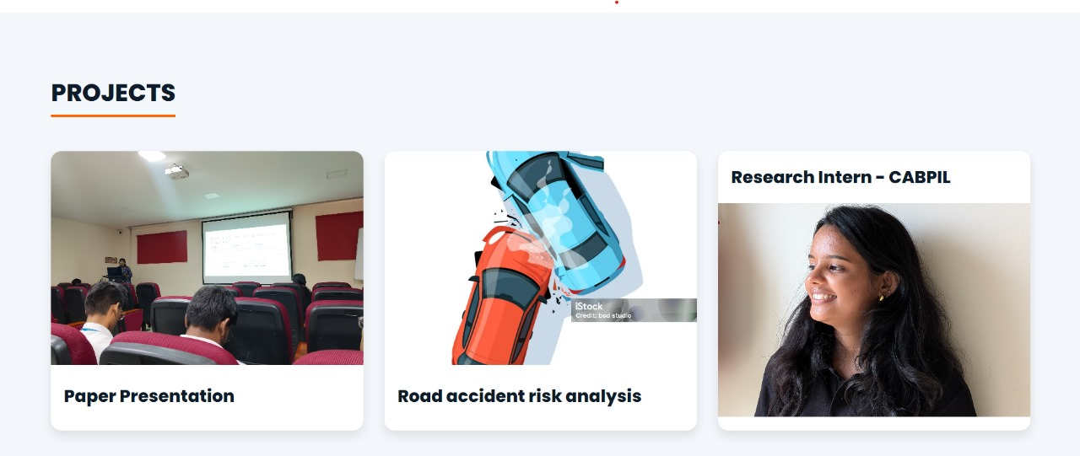
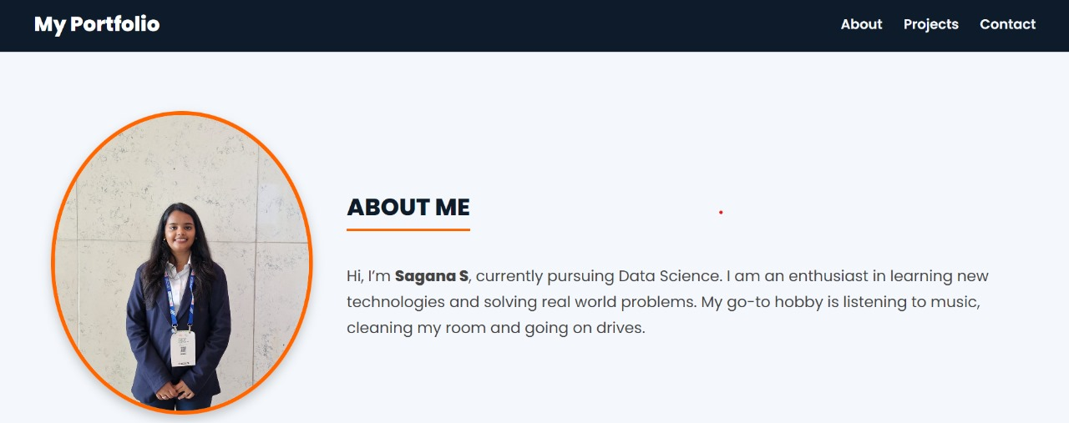

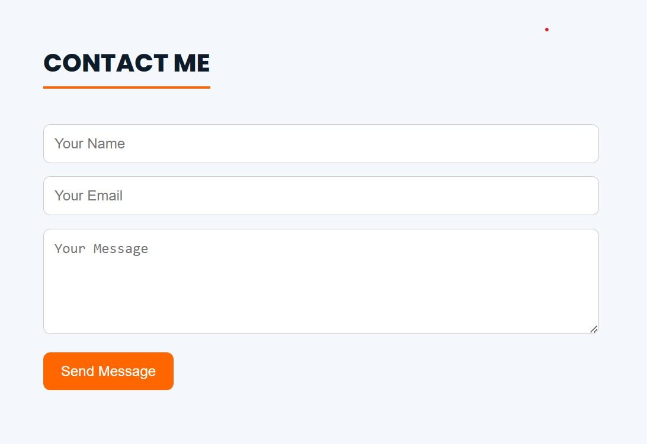
RESULTS AND SCREENSHOTS
3/21/2024 Annual Review
10

Slide 11
CONCLUSION
The Personal Portfolio Website serves as a professional digital platform to present my skills, projects, and achievements in an organized and accessible way. It provides an interactive alternative to traditional resumes, making it easier for recruiters, mentors, and collaborators to know more about my work. This project also reflects my ability to design and develop simple yet effective web solutions using HTML and related tools, while laying a foundation for future improvements such as adding interactivity, animations, or advanced features.
11

